Slide 1
Surface Transportation Board RETAC Coal Producer Update
April 15, 2016
Barbara Porter
Vice President Logistics and Market Optimization
Arch Coal Sales Inc.

Slide 2
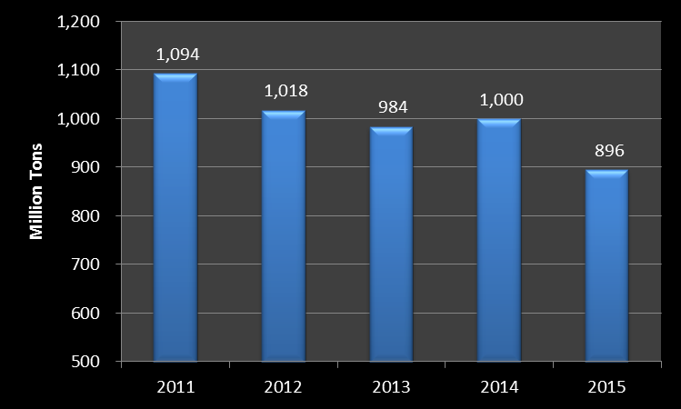
US Coal Production

Slide 3
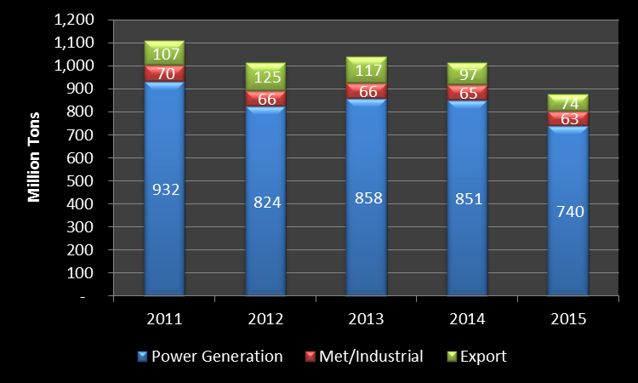
US Coal Demand

Slide 4
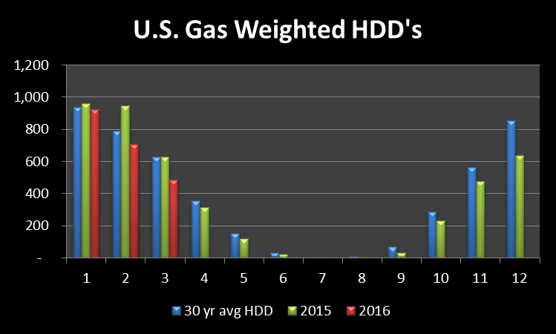
Mild Winter

Slide 5
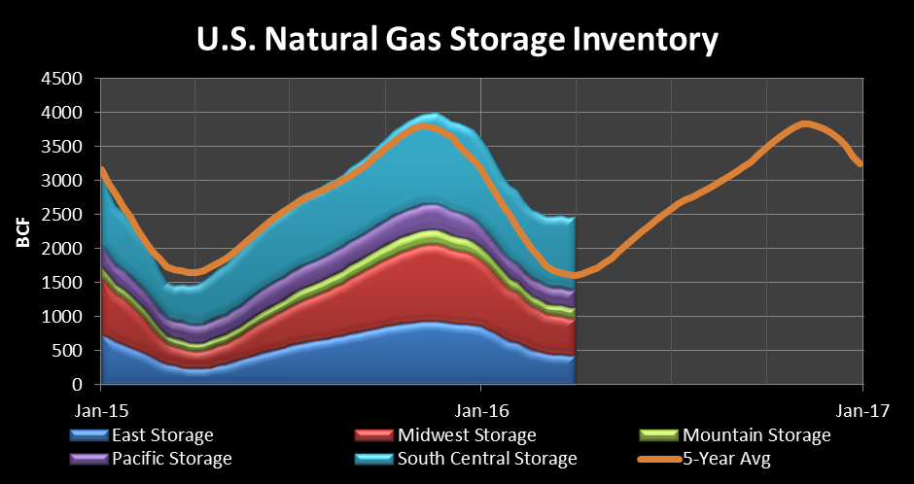
Natural Gas inventories

Slide 6
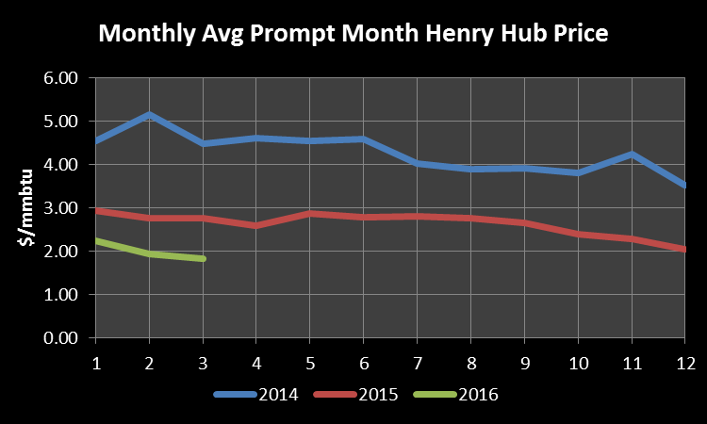
Prompt Natural gas prices

Slide 7
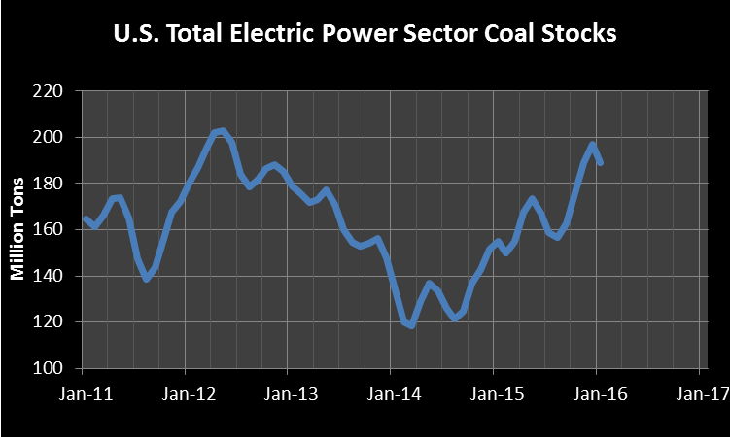
Coal Inventories

Slide 8
Domestic Prices – PRB 8800 BTU

Slide 9
Domestic Prices – CSX 12500 <1

Slide 10
International Prices – API2

